Slide 1
Capstone Project Proposal
Guidelines

Slide 2
Contents
Title Page
Mentor Consent Form
Project Overview
Need Analysis
Literature Survey
Objectives
Methodology
Work Plan
Project Outcomes & Individual Roles
Course Subjects
References

Slide 3
Title Page
Title slide mentioning the
  Project title
  Project mentor name
  Team members (Roll numbers with Names)

Slide 4
(A typical Specimen of Cover Page & Title Page)
TITLE OF PROJECT
Capstone Project Proposal
Submitted by:
(<University Roll Number>)NAME OF THE STUDENT(s)
BE Third Year, CSE/CSE-MBA
Project Team No. _____
Under the Mentorship of
Name of Faculty Mentor
Designation
Computer Science and Engineering Department
Thapar Institute of Engineering and Technology, Patiala
MONTH & YEAR

Slide 5
Mentor Consent Form
I hereby agree to be the mentor of the following Capstone Project Team
Project Title:
Roll No | Name | Signatures
NAME of Mentor: . . . . . . . . . . . . . . . . . . . . . . . . . . . . . . . . . . .
SIGNATURE of Mentor: . . . . . . . . . . . . . . . . . . . . . . . . . . . . . . . . . . . .

Slide 6
Project Overview
Complete overview of the capstone project.
(Max one page-three paragraphs)

Slide 7
Need Analysis
You need to present a short description (One page) of why there is a need for the proposed project and its relevance in the real world.
You may cite some other existing systems/base research papers (details to be mentioned in Literature survey) (Optional)

Slide 8
Literature Survey
You need to carry out a detailed survey in your respective field (2-3 pages).
Present that literature survey of the systems/products already existing in the real world in this section.

Slide 9
Objectives
You need to list the objectives (3-4) that you wish to achieve at the end of the capstone project.
At the end of the final evaluation of the capstone project, these objectives will be used to judge your project completion status.

Slide 10
Methodology
You need to list the methodology of achieving the set objectives, in this section.

Slide 11
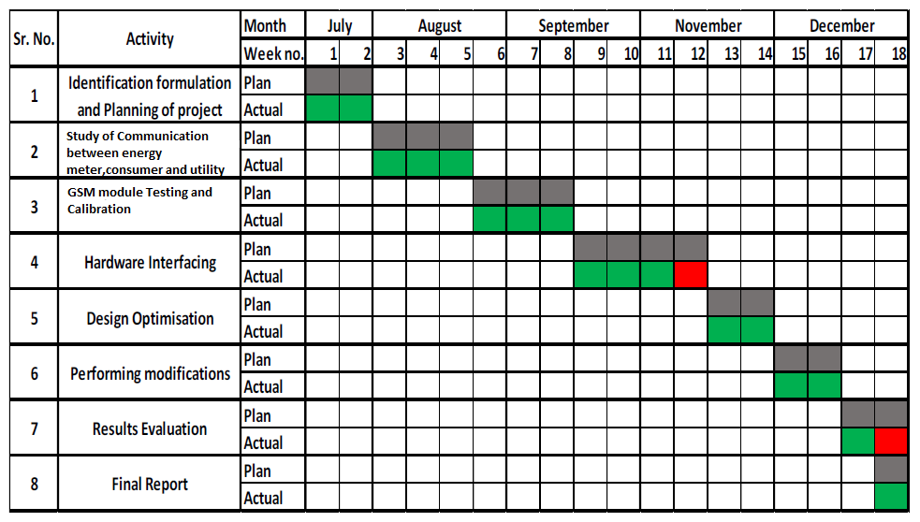
Work Plan
You need to give a short work plan which you will set for achieving the set objectives, in this section.
Sample:-

Slide 12
Project Outcomes & Individual Roles
Here, you need to list the final outcomes/ products/ systems/ deliverables of your capstone project.
The individual team member role must also be clearly specified in this section.

Slide 13
Course Subjects
In this section, you need to list the course subjects that will be used (in the form of conceptual knowledge or practical skills sets) during the successful execution of your capstone project.

Slide 14
References
[1]
[2]

Slide 15
Formatting Guidelines
Project Report Type: Transparencies and tape bound
Number of Copies: 1 per Project group (Max pages 14)
Running text should be justified, figures and tables center aligned, no space before full stop etc.
Use passive voice in text.
Paper Size (orientation): A4 (portrait)
Margins: 1” top / bottom / right and 1.5” left
Font Type: Times New Roman
Font Size: 16 bold for Section names, 14 bold for headings and 12 for normal text
Line Spacing: 1.5 throughout
Page Numbering: Bottom center of page in the format – Page 1 of N
All table and figure captions in size 10 sentence case, table captions on top and figure captions below the figure.
-----contd….

Slide 16
All figures and tables quoted in the text with explanation.
No figures and equations should be copied. Please use smartdraw/ visio for figures and Mathtype for equations.
References (The listing of references should be typed 2 spaces below the heading “REFERENCES” in alphabetical order in single spacing left – justified. It should be numbered consecutively (in square [ ] brackets, throughout the text and should be collected together in the reference list at the end of the report. The references should be numbered in the order they are used in the text. The name of the author/authors should be immediately followed by the year and other details). References should not be cited from Blogs, Twitter etc. but should refer to good Journal or Conference papers. Typical examples of the references are given below:
REFERENCES
[1] Ariponnammal, S. and Natarajan, S. (1994) ‘Transport Phonomena of SmSel – X Asx’, Pramana – Journal of Physics Vol.42, No.1, pp.421-425.
[2] Anderson T. , Peterson L., Shenker S., Turner J.(2005).Overcoming the Internet impasse through virtualization. IEEE Computer, 38(4):34-41.
[3] W. Zeng, H. Yu, C. Lin. (2013, Dec 19). Multimedia Security Technologies for Digital Rights Management [Online]. Available: http://goo.gl/xQ6doi

